Slide 1
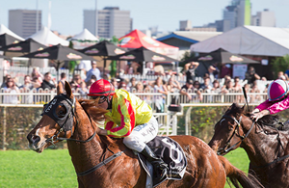
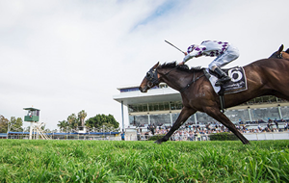
RACE DAY
SATURDAY
9TH JUne 2018
COME ALONG AND
ENJOY AN AFTERNOON
AT THE RACES
Cost: $40 per head
Includes: Bus Trip,
Entry to Races
Progressive Food
To avoid disappointment, please put your names on the list provided by 1st June 2018
Bus will leave Manning Bowling Club
Challenger Avenue, Manning around 11 a.m.

